Slide 1
Call of Adventure
2D RPG

Slide 2
Original Concept or What we scrapped
2-D ¾ view RPG → 2D Top-down RPG
Unlockable Characters
Orcs
Rescuing characters
Level up system and inventory system
Introductory block of text
Boss

Slide 3
What stayed in:
Goblins and Ogres
Three main characters
Turn-based combat system
Basic menu design

Slide 4
Contribution
Filip Nejedly - Team Leader/Lead Programmer – AI, Audio Scripts, Camera Control, Scene Transformations, Player Spawning, Map Design, Combat Transformation
Brian Latt – Creative Director – Animations, Character Design, Effects, Map Design
Konstantinos Themelis – Enemies Design, In-game menu, Audio Script
Brandon Nemeth – Enemies Design, Floor Graphics, Animations
Sergio Murzin – Combat Scene
Danurshiyan Sivakumar - //

Slide 5
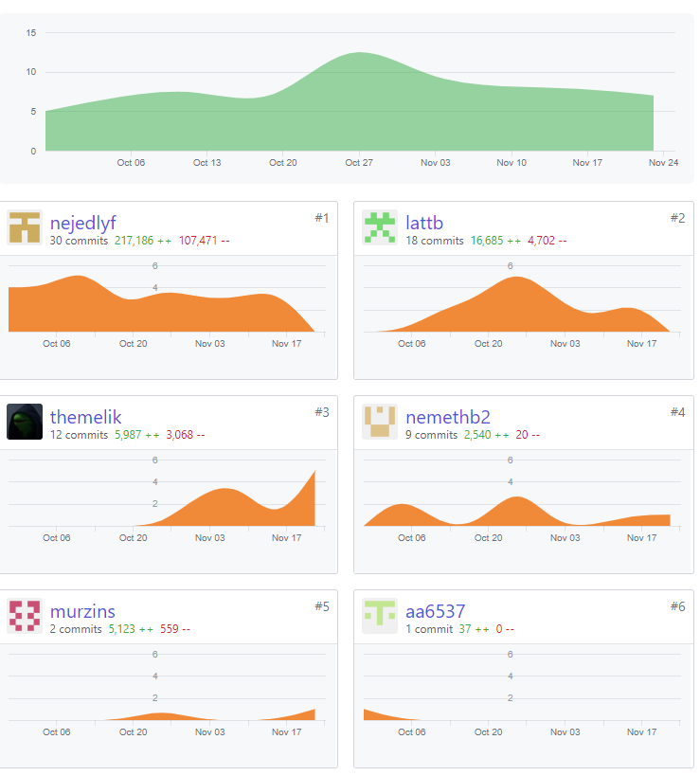
Contributions in the Graph

Slide 6
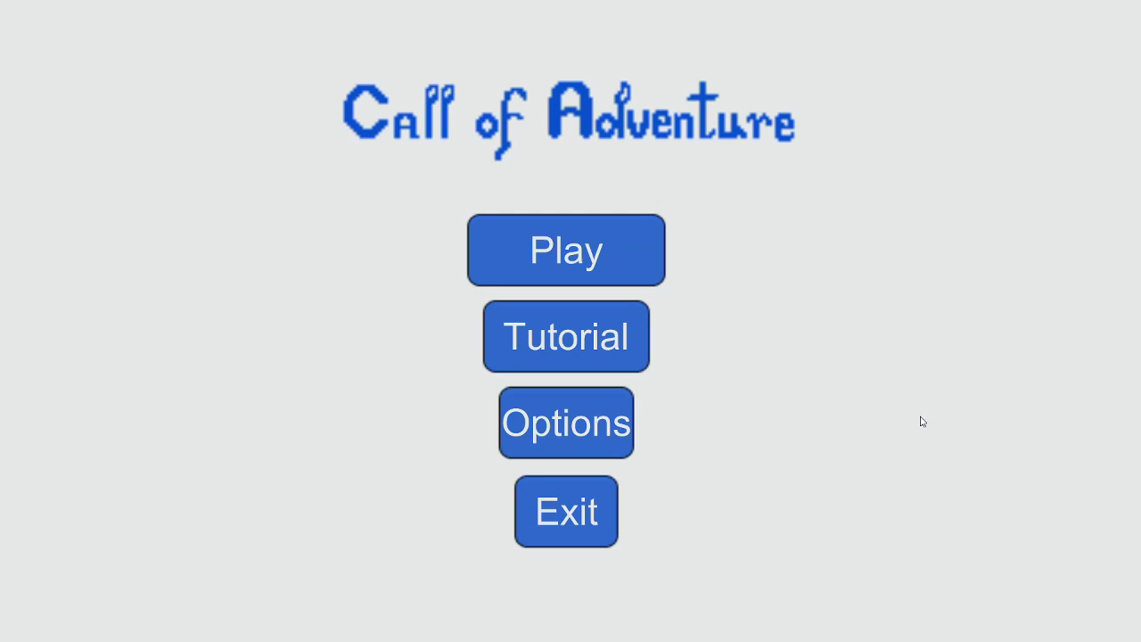
Video

Slide 7
The Good
The finalisation
We learned a lot
Team Dynamics

Slide 8
And the bad
Communication problems
Unreliability
Technical Difficulties

